Slide 1
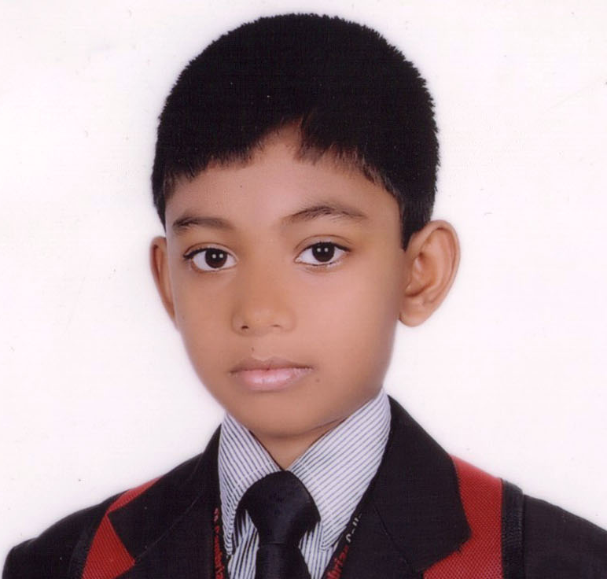
Welcome to my presentation dear friends.

Slide 2
Identity of the presenter & class
Abu Talib
A student of
class IX
Group-Science
ID-CSSB 150-015
Presentation made for the students of class IX
Subject : English 2nd Paper
Paragraph

Slide 3
Let’s enjoy
What is the video about?
Environment

Slide 4

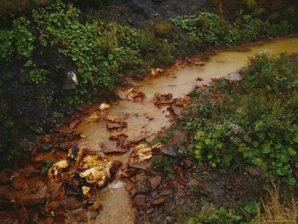
Clean environment
Why?
Let us see in a---
Polluted environment

Slide 5
Environment is a combination of house, trees, animals, roads, rivers, institutions, air, water, soil and so on. Among all these are air, water and soil are the main elements of the environment. But the environment is becoming a great threat because of environmental pollution. There are so many reasons of environment pollution. Firstly we burn fuels, that creates smoke and the smoke is mixed with air. Secondly we are cutting plants and killing animals indiscriminately. The plants are called factory of receiving carbon dioxide and releasing oxygen. Water pollution is another problem that we are facing now. Sea and river water is being polluted by industrial waste thrown in it. Pesticides and chemical fertilizers used by farmers are washed away by rain water and mixed with river and pond water. So existence of aquatic animals and plants is becoming risky. Soil is polluted by the use of pesticides and chemical fertilizers. The polybags mix up with soil and destroy its fertility. As a result plants and crops are not growing well. All these cause a serious negative effect on our existence. So it is high time we took proper measures to stop pollution and save our environment. In order to stop pollution we should take some measures. We should control the burning of fuels, stop cutting trees at random, planting more trees regularly, use natural fertilizer instead of chemical fertilizer and stop throwing waste materials in the rivers and canals and after all we should keep our environment clean. If we can do so, we are sure to ensure a happy and peaceful environment.

Slide 6
Our today’s lesson is a paragraph
Environment pollution

Slide 7
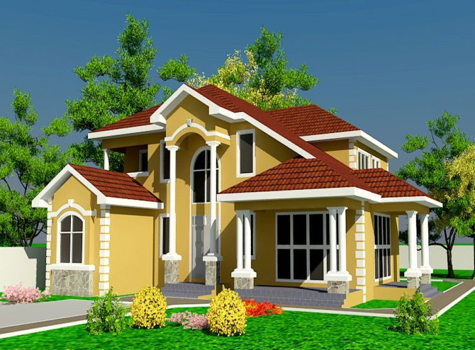
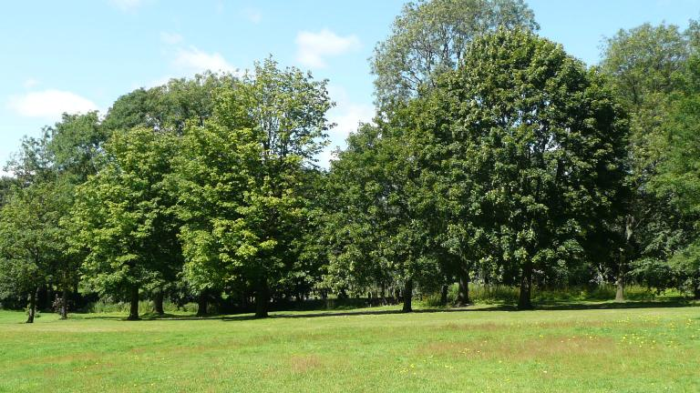
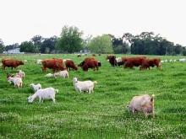
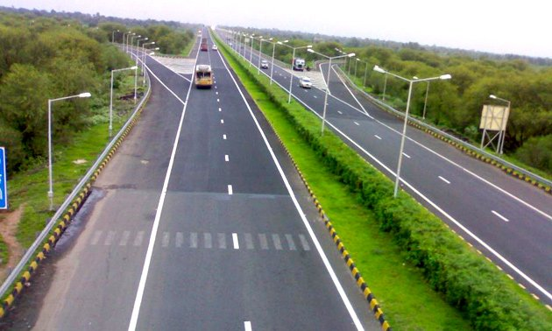
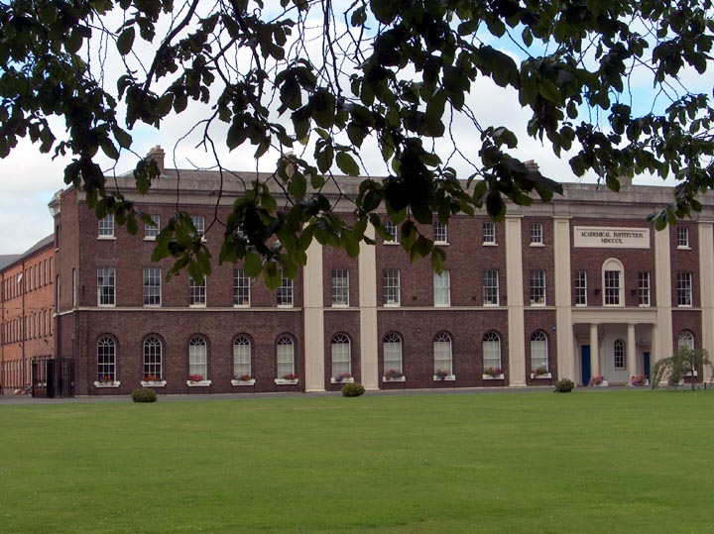
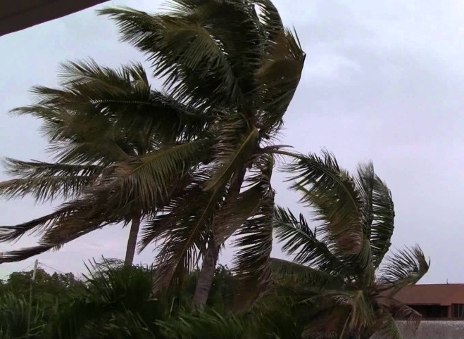
What is environment?
Environment is a combination of-
house
trees
animals
roads
institutions
air

Slide 8
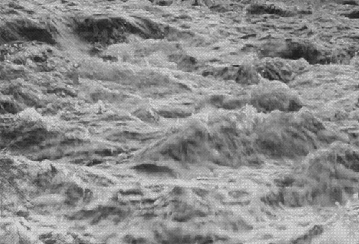
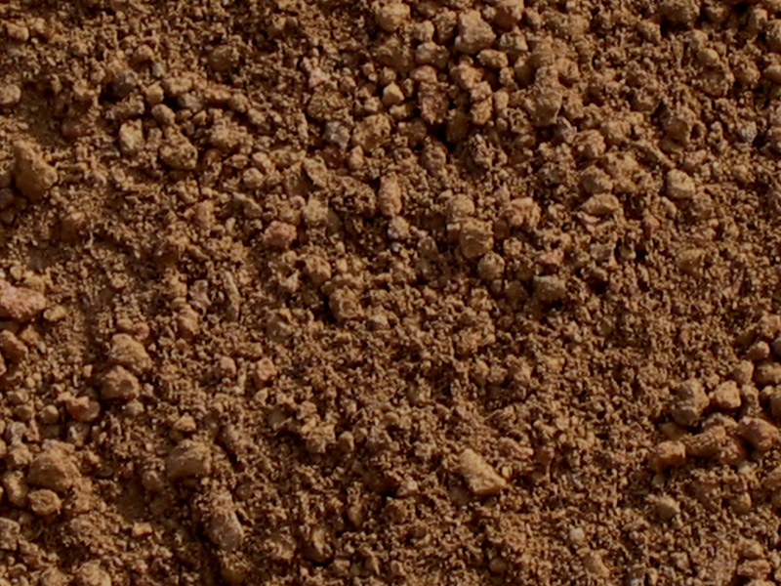
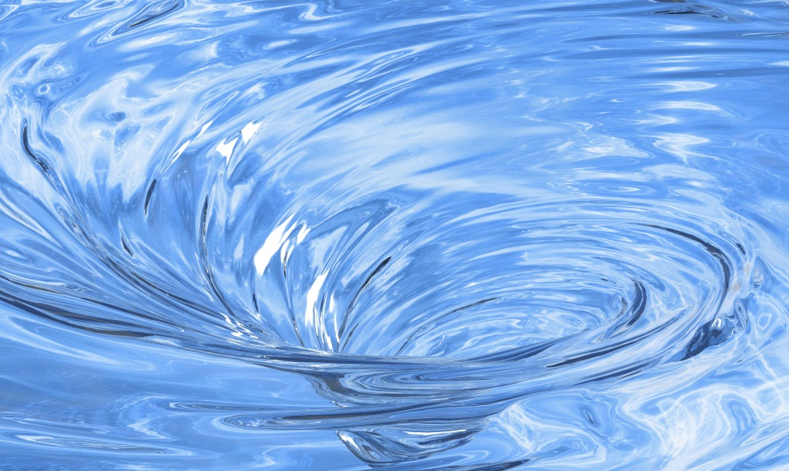
rivers
soil
and water

Slide 9
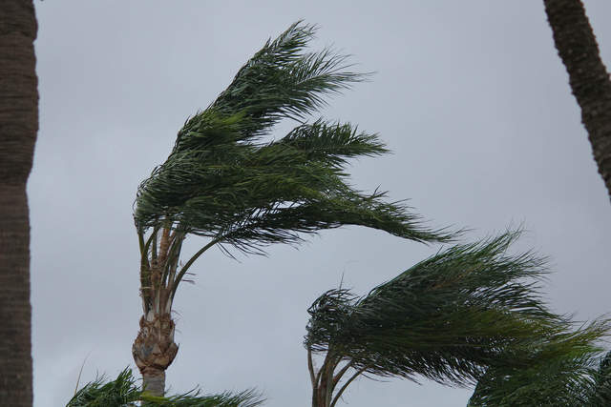
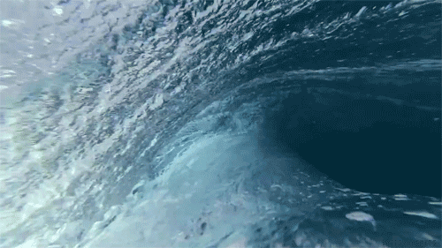

Which elements are important among them?
Among them-
air
water
soil
are the main elements of the environment.

Slide 10
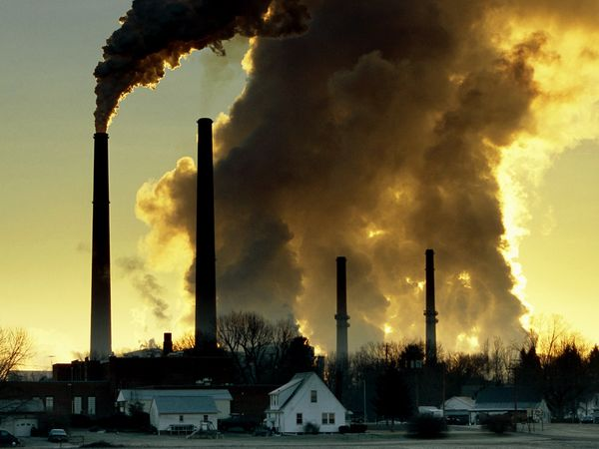
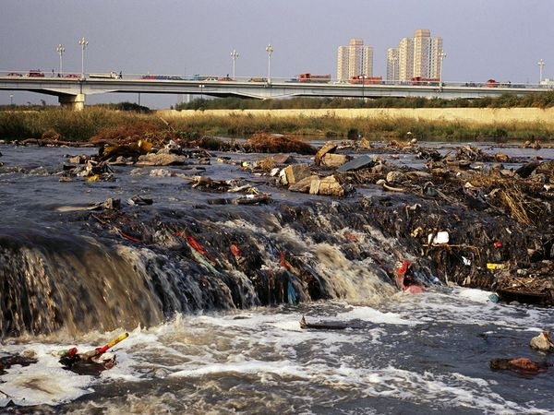
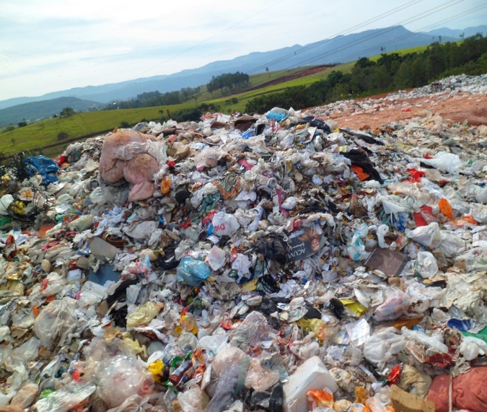
What is the condition of the environment now?
The condition of the environment is not at all good because of environmental pollution.

Slide 11
Why?
There are so many reasons of environment pollution.

Slide 12
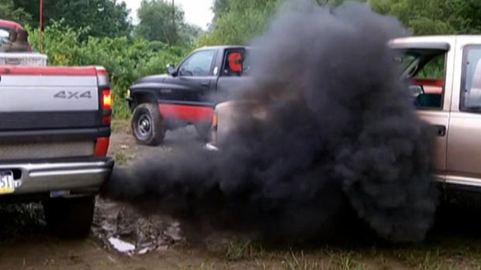
Firstly we burn fuels, that creates smoke and the smoke is mixed with air and air is polluted.

Slide 13
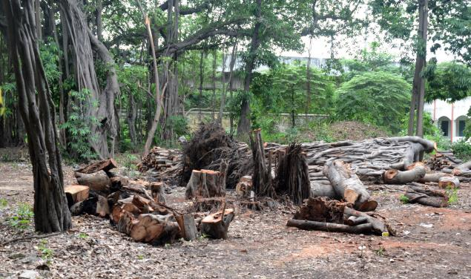
Secondly we are cutting trees and killing animals indiscriminately.

Slide 14
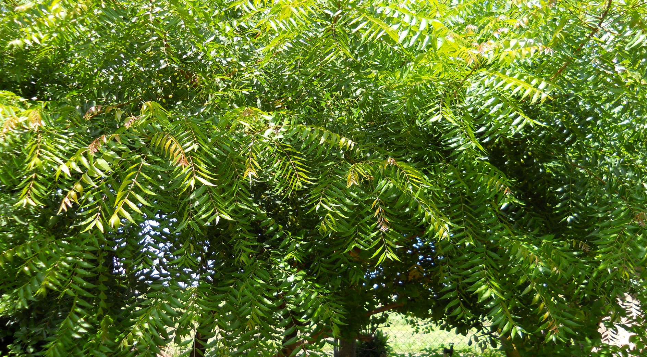
The plants are called the factory of receiving carbon dioxide and releasing oxygen.

Slide 15
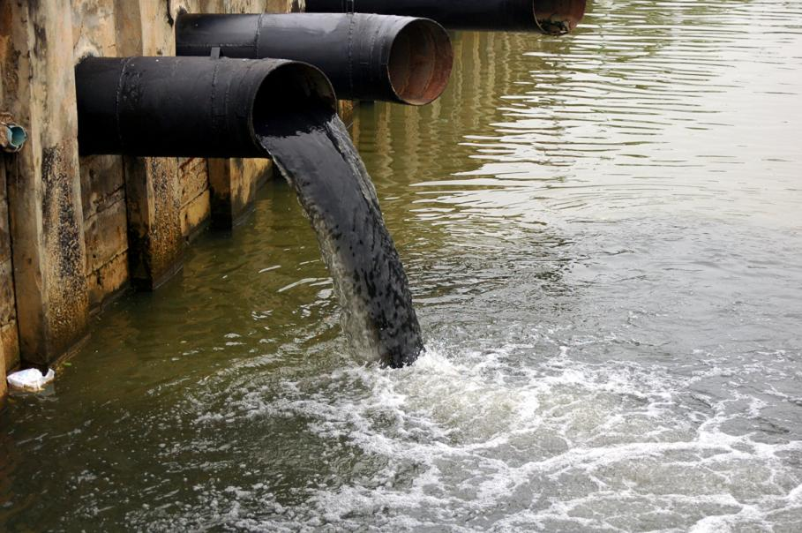
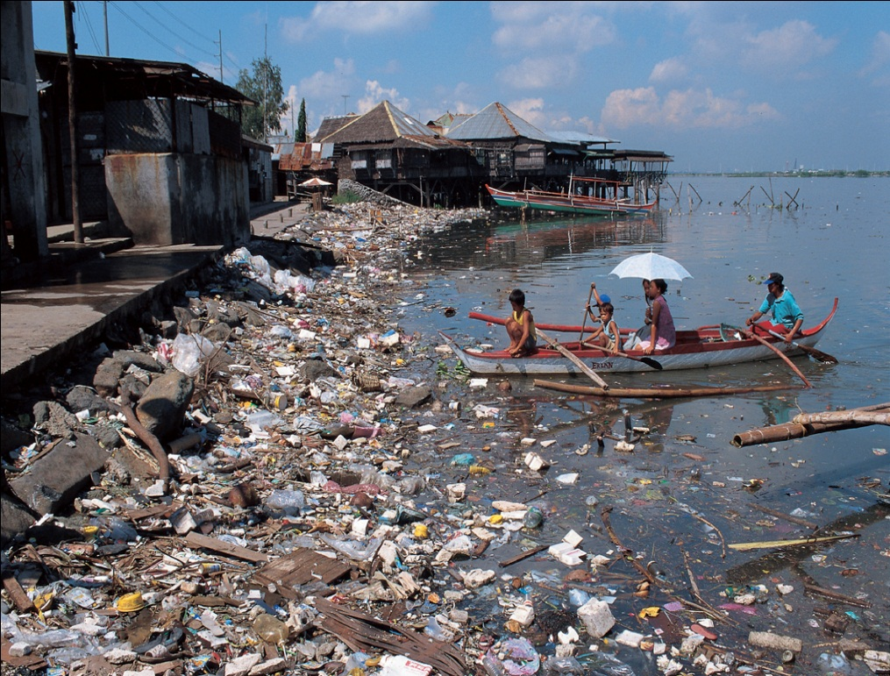
Water pollution is another problem that we are facing now. Sea and river water is being polluted by industrial waste thrown in it.

Slide 16
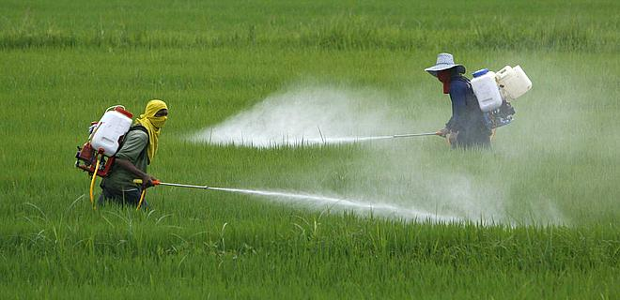
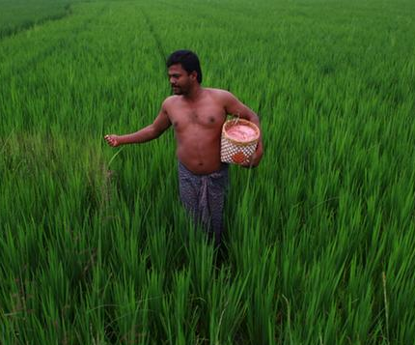
Pesticides and chemical fertilizers used by the farmers are washed away by rain water and mixed with river and pond water.

Slide 17
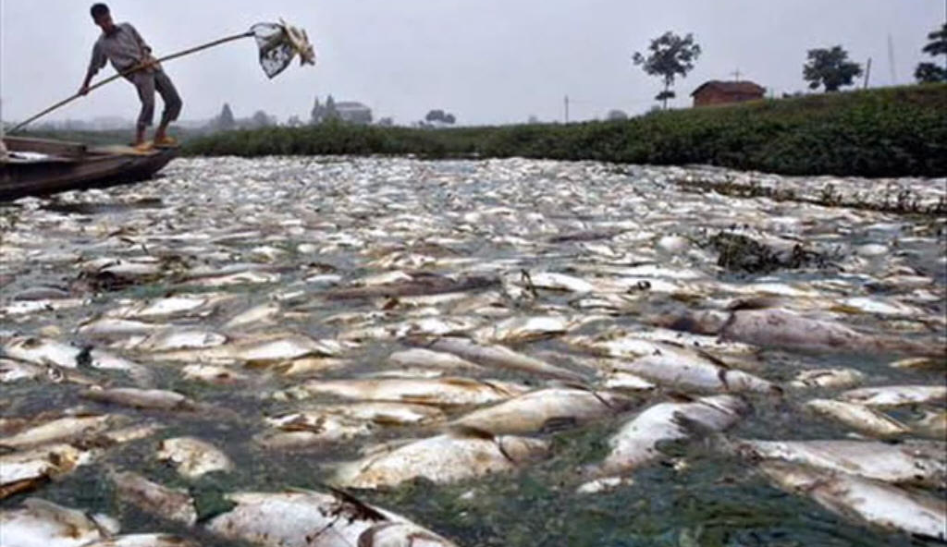
So existence of aquatic animals and plants is becoming risky.

Slide 18

The polybags mix up with soil and destroy its fertility. As a result, plants and crops cannot grow well.

Slide 19
What do these cause ?
All these cause a serious negative impact on our existence.

Slide 20
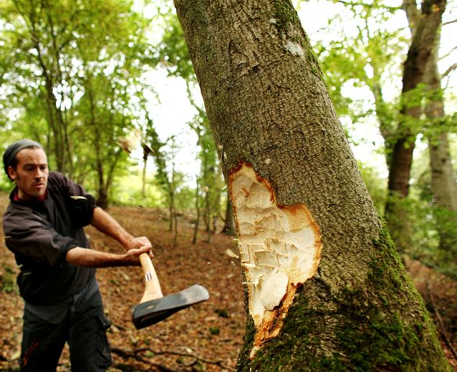

In order to stop pollution we should take some measures. We should control the burning of -
fuels, stop cutting trees at random,

Slide 21
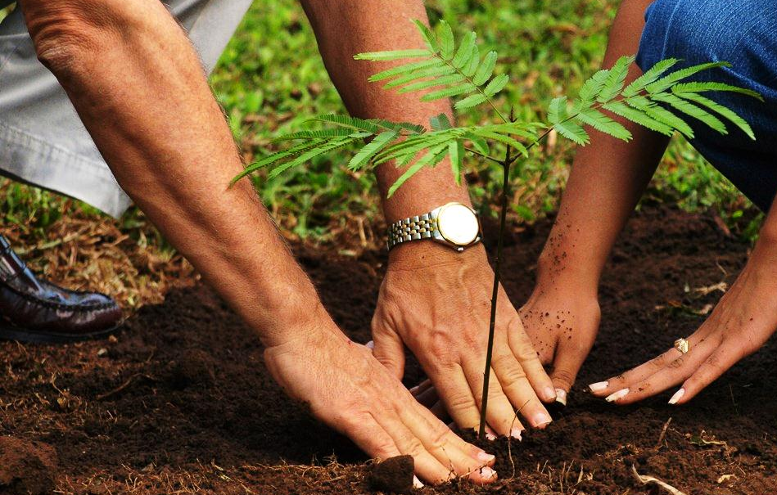
planting more trees regularly,

Slide 22
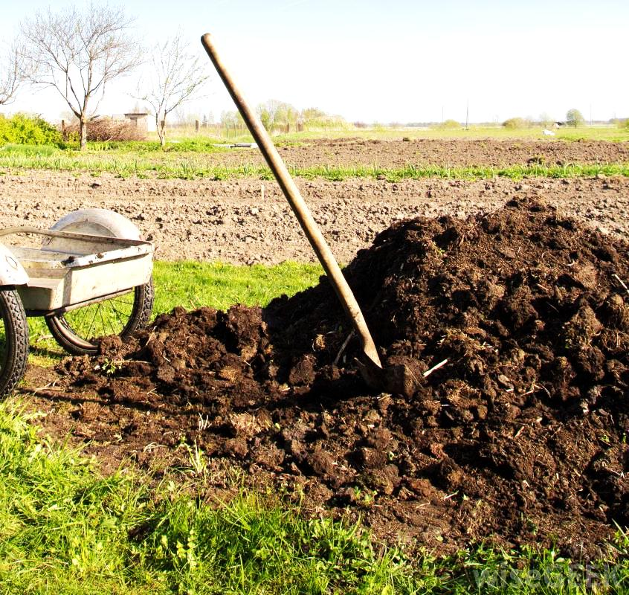
using natural fertilizer instead of chemical fertilizer

Slide 23
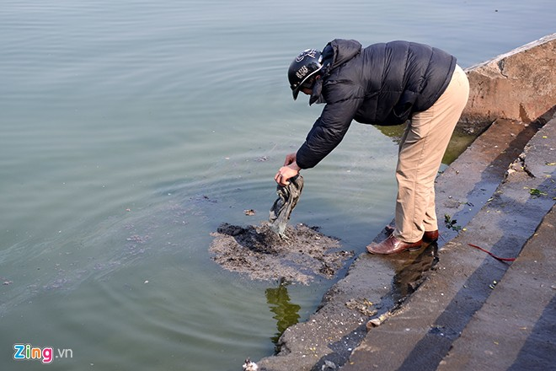
and stop throwing waste materials in the rivers and canals

Slide 24
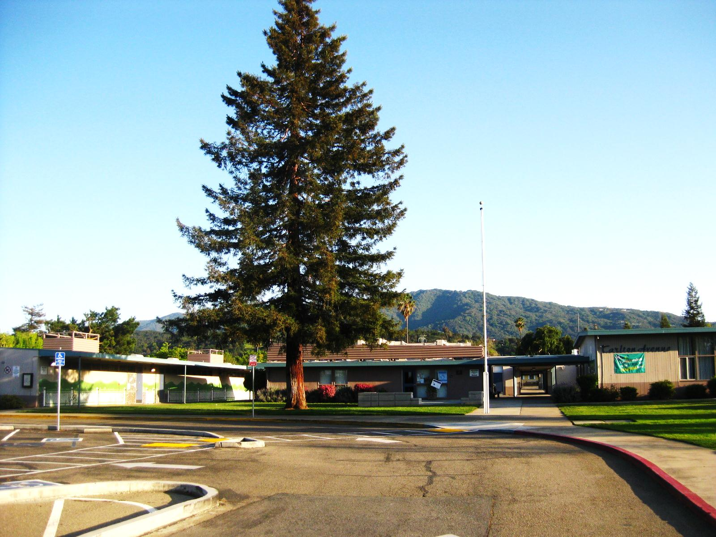
and after all we should keep our environment clean.

Slide 25
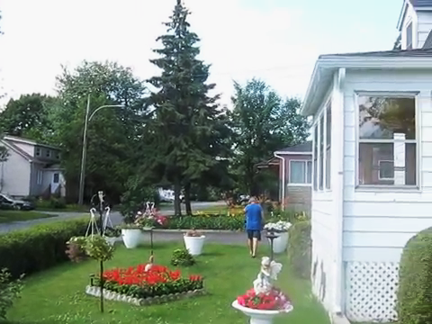
If we can do so, we are sure to ensure a happy and peaceful environment.

Slide 26
Thank you so much my friends.

